Slide 1

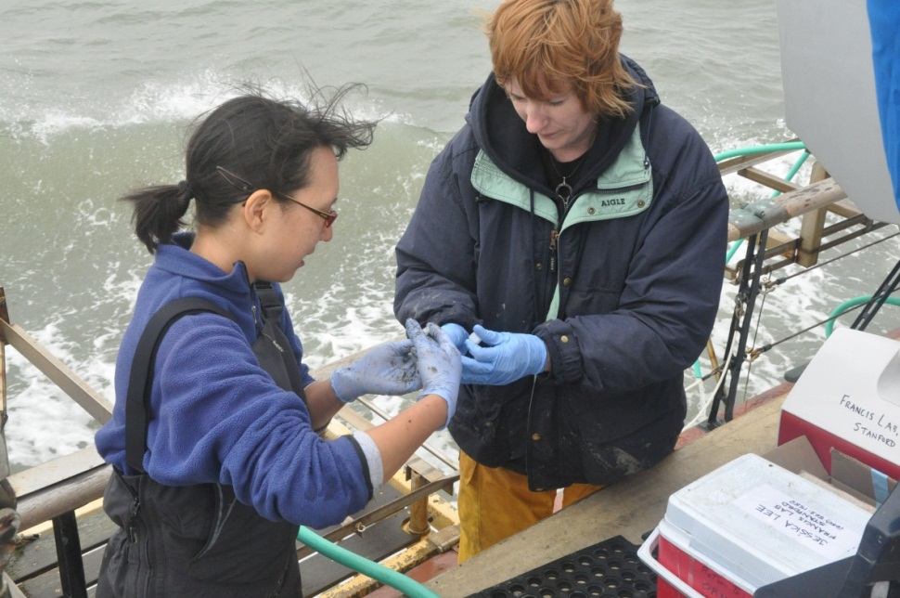

Summer Fellowship Program
Unique Paid
Professional Development for Teachers
Notes:
This is a basic overview of IISME that you can use in your commercial to other teachers.
You can take out slides to shorten this, and you can add information about your personal fellowship experience—which is likely what will be most interesting to your colleagues.
Take or leave the notes as you see fit.

Slide 2

When’s the last time you heard a student say…
Why should I learn this?
When will I ever need to know this?
What does this have to do with anything?
Notes:
I want to take a few minutes to tell you how I’ve been able to answer these questions for my students having held a Fellowship through IISME.

Slide 3

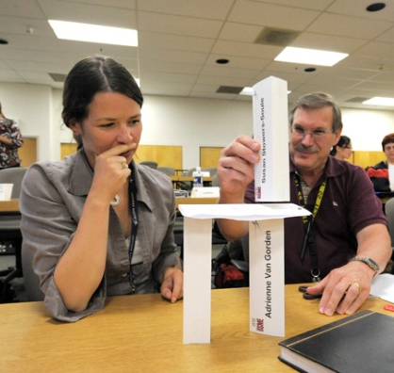
‘s Purpose
Industry Initiatives for Science and Math Education (IISME™) was founded in 1985 by a consortium of San Francisco Bay Area industries in partnership with the Lawrence Hall of Science at the University of California at Berkeley. IISME seeks to transform teaching and learning through industry-education
partnerships--bringing excitement
and relevance to the classroom.
Photo Credit: Lockheed Martin Corporation
Notes:
This summer, I was one of 165 teachers from around the Bay Area who was lucky enough to hold an 8-week position in an industry or research organization.
Industry Initiatives for Science and Math Education (IISME) is a nonprofit organization that provides research and industry-based professional development opportunities for K-16 teachers in 8 San Francisco Bay Area counties.
(Alameda, Contra Costa, Marin, San Francisco, San Mateo, Santa Clara, Santa Cruz County, Solano, LA, Orange and San Diego)
We see teachers as the agents of change, who by experiencing industry/research for the first time or by getting a refresher on that, will translate that relevancy and excitement to their students.
Embarking on our 29th summer.

Slide 4
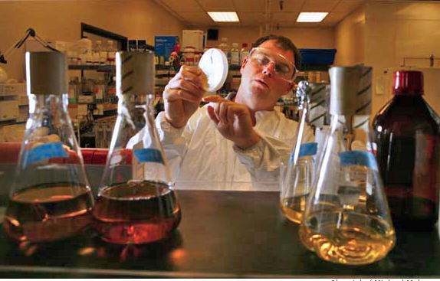
What is an Fellowship?
Fellows complete a project on site for 8 weeks in industry, a government agency, or a university.
Fellows use 10% of their paid time to work on curriculum development and to collaborate with other teachers.
Fellows meet with other teachers in community groups, in virtual groups, at meetings, with IISME coaches, and one-on-one to reflect on their learning, share best practices and
hone their teaching skills.
Notes:
The IISME Summer Fellowship Program provides teachers with the opportunity to work full time for 8 weeks in industry, a government agency or university, where we get to experience, first hand, what the 21st century workplace is like.
In the summer of 2012, I was lucky enough to receive a position to work with _____ (name of Host organization) as a _______ (job title).
One of the wonderful benefits of holding an IISME Summer Fellowship is that 10% of your paid time is dedicated to working on ways to transfer what you’re learning during the Fellowship back into your classroom or school. The main focus of that 10% time is dedicated to developing an Education Transfer Plan to enhance our curriculum and bring our new found knowledge back to our students.
This was such a valuable experience, because….(fill in your own bullets—these are just ideas…)
It gave me an opportunity to experience the kinds of skills that our students will need to be successful in today’s workplace
It gave me the time and support to really plan how I could make a lesson/unit relevant for my students
I was reminded how my subject area is applied in the world outside of school and was able to update my skills/knowledge in this area.

Slide 5
Who hosts Fellows?
Adobe Systems
Aerospace Corporation*
Agilent Technologies
Applied Materials, Inc.
Autodesk, Inc.
BD Biosciences
California Water Service Co.
Cisco Systems, Inc.
Citrix Systems, Inc.
CK-12 Foundation
Coherent, Inc.
Cordis Corporation
Cypress Semiconductor
Dow Chemical Company
El Camino Hospital/South Asian Heart
EMC Corporation
Ericsson
eSilicon Corporation
Fairchild Semiconductor
FUJIFILM Dimatix, Inc.
Genentech
Gladstone Institutes
Hewlett-Packard Co.*
Integrated Device Technology, Inc.
Intel Corporation
JDS Uniphase Corporation
KLA-Tencor Corporation
KQED
* Southern California Hosts
Notes:
This is just the list of the A-L companies who offered fellowships in last 2 years
As you can see, there are an incredible number of Host organizations that partner with IISME to provide meaningful Fellowships to Bay Area teachers. All of the Hosts listed on this slide and the next have hosted teachers over the past 2 years.
Although the majority of IISME Fellowships are held at tech companies, one of the additional exciting opportunities for participating teachers are a growing number of science-rich research Fellowships being offered at Stanford and Berkeley Universities. (This year we had 25 Fellows working in chem/bio/physics labs at Stanford).
Some new orgs that were exciting this past year were KQED and FUJIFILM
Lockheed has Hosted all 28 years.

Slide 6
Who hosts Fellows?
Lawrence Berkeley National Laboratory
LifeScan, Inc.
Life Technologies Corporation*
Lockheed Martin Information Systems and Global Services*
Lockheed Martin Space Systems Co.
Lucile Packard Children’s Hospital
Mattson Technology
MiaSolé
MoSys, Inc.
National Semiconductor
NetApp
Nordson ASYMTEK*
NVIDIA
Palo Alto Research Center (PARC)
PLX Technology
SanDisk Corporation
Santa Clara University
SAP Labs
Silicon Valley Leadership Group
SRI International
Stanford University
SVB Financial Group
Synopsys, Inc.
UC Berkeley
UC San Francisco
Violin Memory, Inc.
* Southern California Hosts
Notes:
Due to the large number of Host organizations that choose to host teachers, the types of fellowship opportunities vary widely and change every year.
Teachers hold Fellowships in the areas of:
Biotechnology,
Chemistry,
Curriculum Development,
Community Relations,
Engineering,
Human Resources,
IT,
Software Development,
Technical Writing,
Marketing, etc.
The positions can take on a lot of different forms from:
developing intranet websites,
to working in science labs,
to managing teams,
to creating marketing materials for new products,
to developing curriculum using new technology tools, etc.
Won’t know exact positions until March, but there is a full list of positions that teachers have held on the IISME website at www.iisme.org/samplejobs.cfm

Slide 7
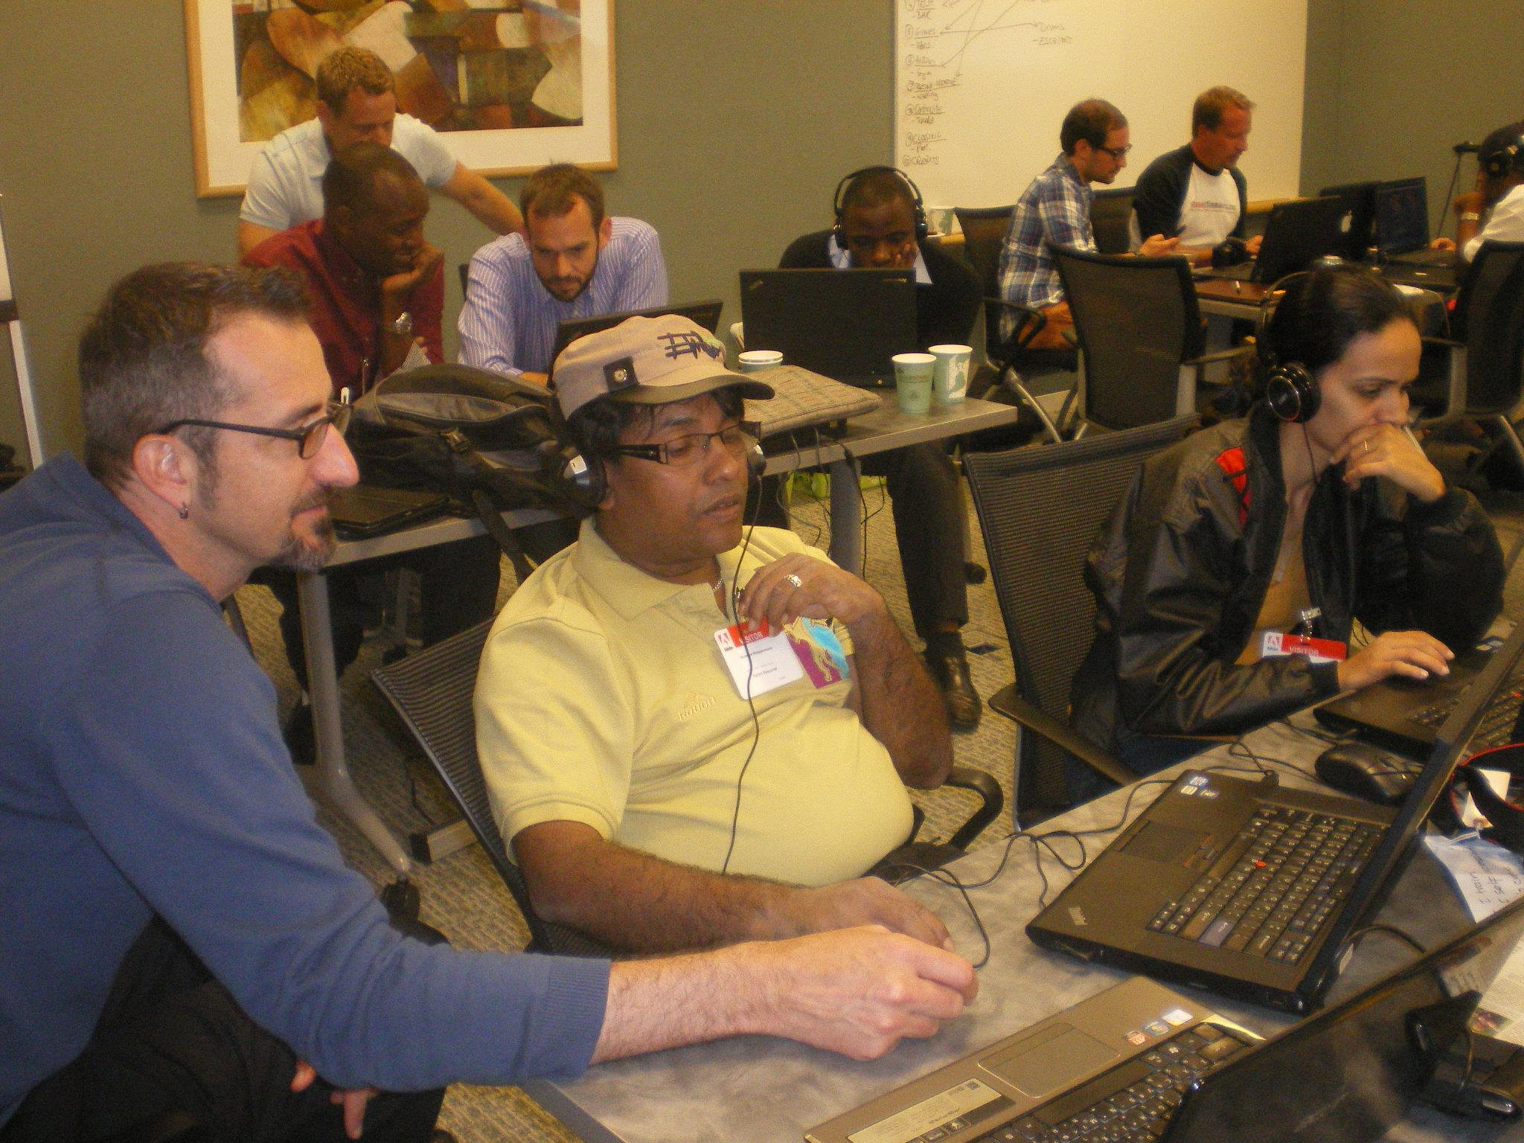
What is an Fellowship?
Adobe Systems Inc./Adobe Youth Voices
  Developed Curriculum for AYV Workshops and articulated programs alignment to new Common Core Standards
  Web-Site Work/Encoding and Uploading Media
  Helped launch Adobe Essentials at ISTE/Discovery Conferences and lead workshops for educators
  Organized AYV Lead Educator Summit and assisted teams in their productions.
  Developed ETPs: ePortfolio and
  Digital Publishing Projects
Notes:
Every Fellowship experience is unique, but I want to share a little about mine to give you an idea of the kind of experience you could have.
If you have one, add your own picture.

Slide 8
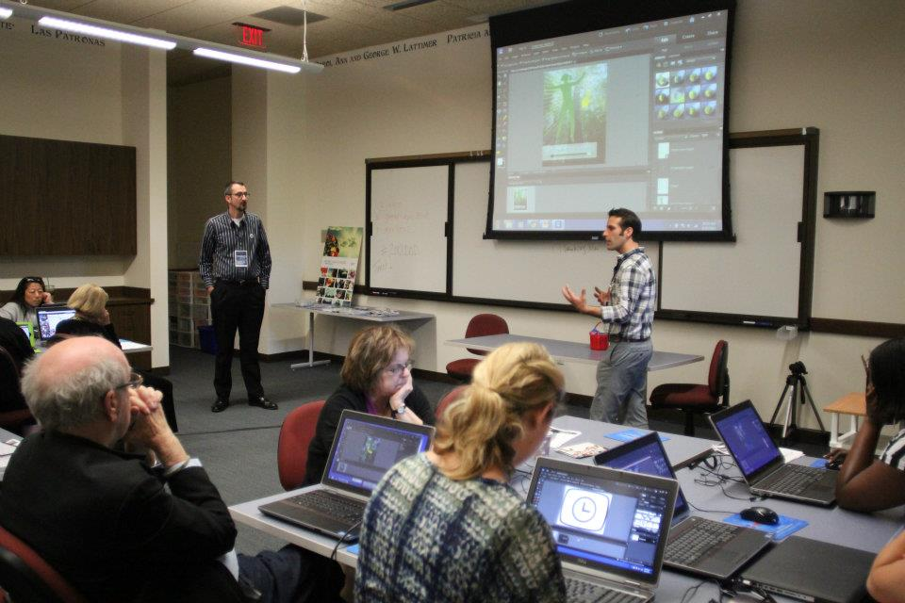
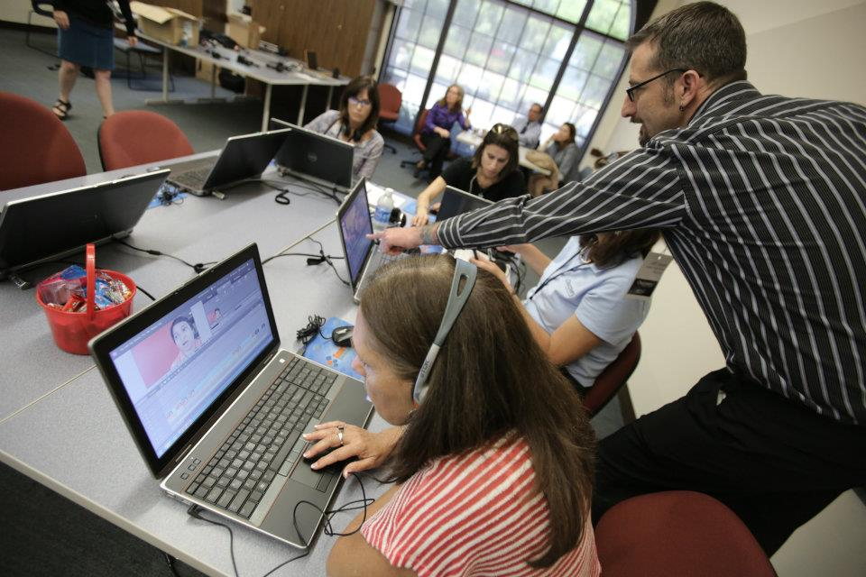
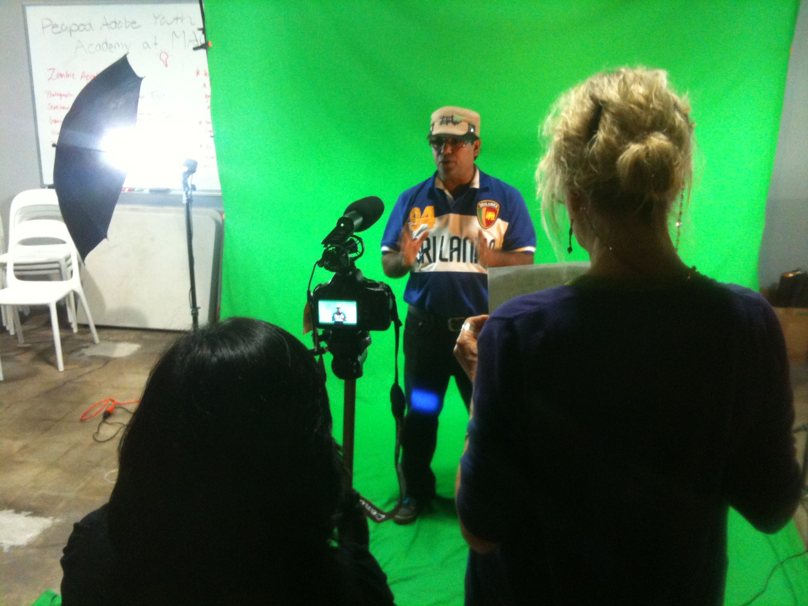
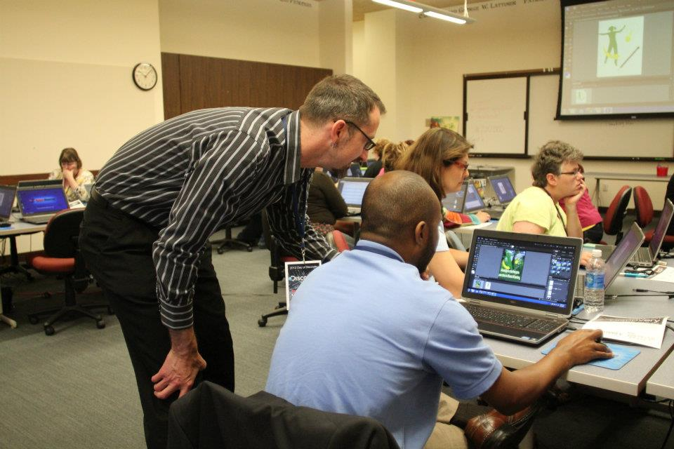
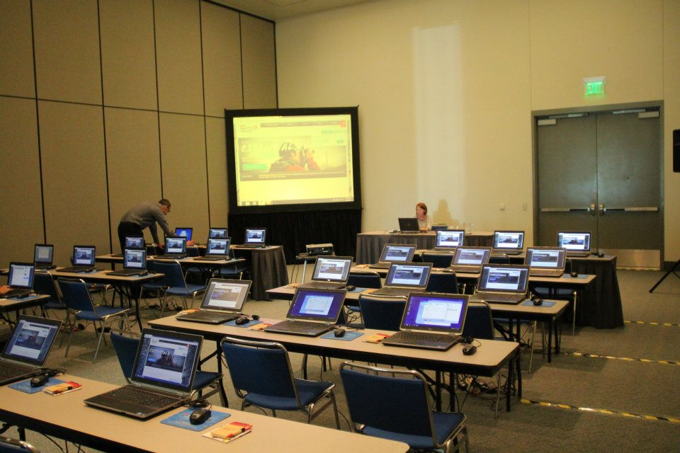
What is an Fellowship?
Notes:
Every Fellowship experience is unique, but I want to share a little about mine to give you an idea of the kind of experience you could have.
If you have one, add your own picture.

Slide 9
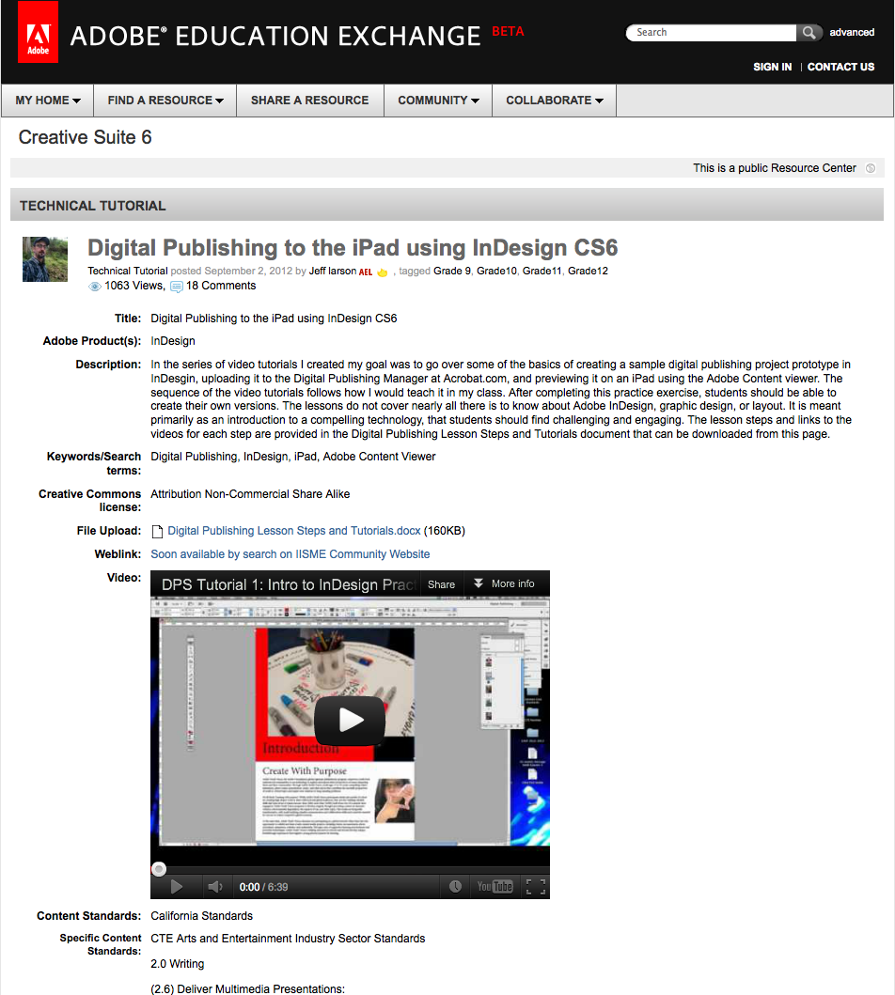

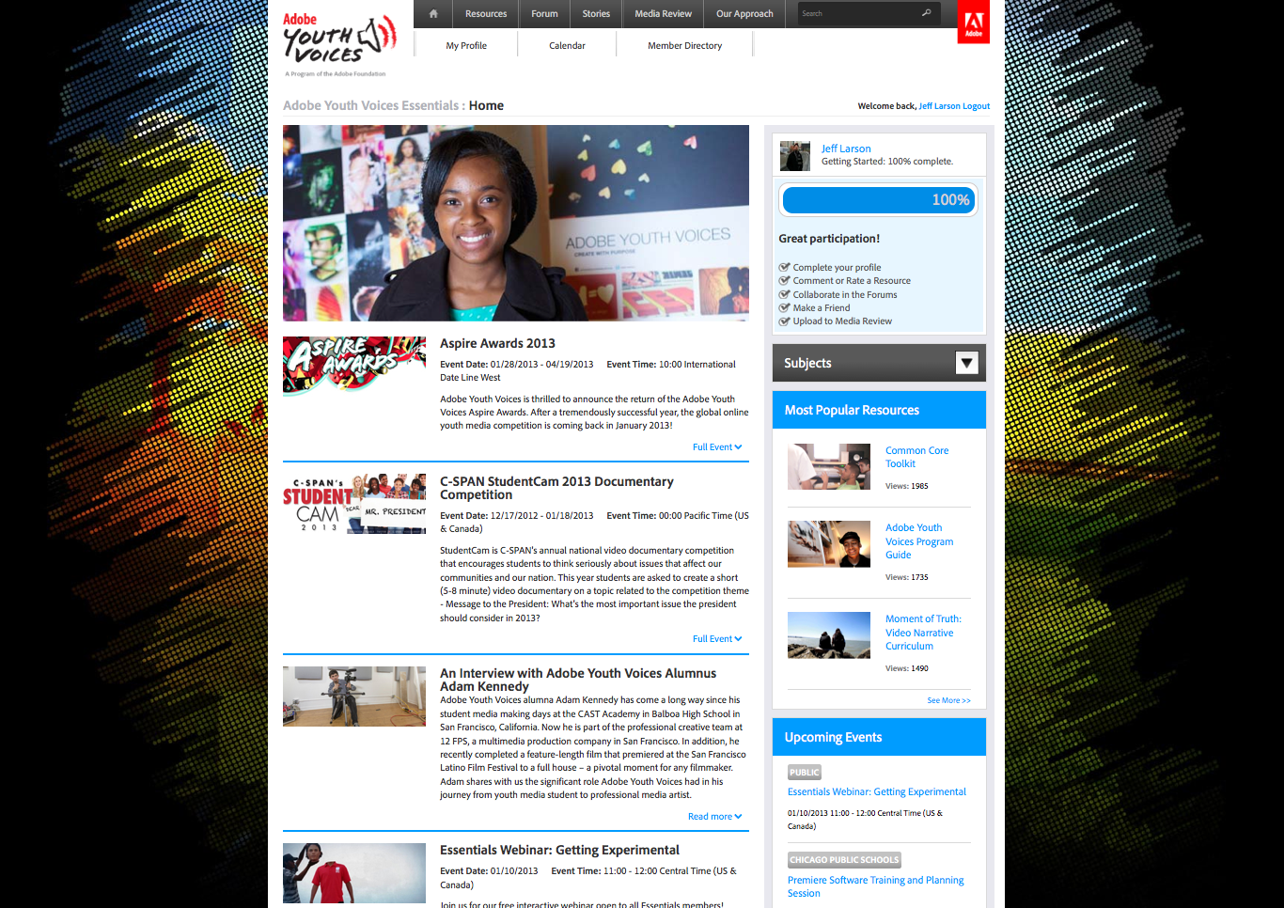

What is an Fellowship?
Notes:
Every Fellowship experience is unique, but I want to share a little about mine to give you an idea of the kind of experience you could have.
If you have one, add your own picture.

Slide 10
Why work during the summer?
100% of Fellows would recommend the IISME Summer Fellowship Program to their peers.
99% reported their Mentor was committed to providing opportunities to learn and gain expertise in new areas.
98% said it stimulated their thinking on ways to improve their teaching.
97% gained a greater understanding of the applications of science, math or technology in every day life.
96% said it elevated their enthusiasm for
teaching.
95% increased their knowledge of careers
that utilize science, math or technology.
Notes:
Although you may think you’d be worn out after working all summer, IISME fellows consistently report that they actually feel more energized and excited for the next school year.
As you can see from IISME’s most recent evaluation results (2012 Fellows), teachers consistently rate their IISME Fellowships in the top 10% of all their professional development experiences. Also, teachers who have held an IISME Fellowship are much more likely to stay in the teaching profession than those who don’t. So, for many of us, it re-ignites our excitement for teaching.
Though these numbers are from 2012, this is consistent feedback we’ve gotten over the 28 years we’ve offered these opportunities.
(Ask former Fellows if they want to say a few words about their experience? What effect it had on them?)

Slide 11
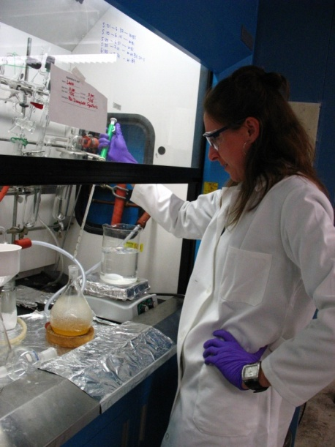
What are the perks of participating in the Summer Fellowship Program?
Professional Growth
Meaningful exposure to the modern workplace/ skill requirements
Experience with the practical applications of today’s curricula
School Resources/Ideas
Authentic stories about today’s career opportunities
New technologies or skills integration
Networking Opportunities
Professional community of educators
Inspiration and support for infusing standards-based curricula with real-word applications
Opportunities to leverage Host visits, educational programs and other resource
Compensation
Up to $8,200 income ($900 per week, plus $1000 in Fellowship Grants)
Professional development hours and university course credit
Notes:
HIGHLIGHT: networking is a perk that many of our teachers benefit from. They make lasting connections with companies/organizations that become a resource for role models, other educational programs and even technology donations.
One teacher mentioned casually to a VP that her school needed a set of laptops, and he said, OK.
Compensation detailed on next slide

Slide 12
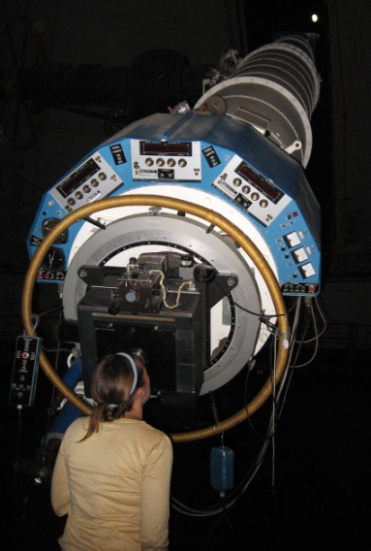
Helps Teachers Afford to Teach
Teacher Stipend
  $7,200
  ($900/week for 8 weeks of full-time work)
Fellowship Grants
  $1000 for completing Education
  Transfer Plan and Reporting on
  the Impact of the SFP on your
  teaching
Fund for Innovation
  Up to $1000 *competitive
Notes:
A teacher was asking me the other day, “we have to pay $7,200 for a fellowship?”
NO! WE PAY YOU!
On top of all the perks I’ve already spoken about, teachers also get to make money, which is very helpful—particularly with the cost of living in the Bay Area.
8200 is guaranteed $ if Fellows meet all the program requirements.
Almost $20,000 in FFI grants given last year/ over ½ of requests were funded.

Slide 13

What is required to be an Fellow?
1. Teach in Our Service Area
Teaching any discipline, K-16
Employed full-time in Alameda, Contra Costa, Marin,
San Francisco, San Mateo, Santa Clara, Santa Cruz,
Solano, Los Angeles, Orange or San Diego County.
Contract for the following year in our service area.
2. Committed to Teaching
Two years teaching experience
Principal’s signed endorsement
Committed to continuing to teach for at least the next three years.
3. Able and Available to Work Full-Time in a Non-Teaching Job
Have a legal right and necessary documents to work in the US in a non-teaching job.
Available full-time during standard business hours for the Fellowship period.
Notes:
Hosts want to support local schools, so teachers must teach in our service area.
Our program is about keeping teachers in teaching—we can’t impact students if teachers leave the classroom.
Fellows work full-time, standard business hours (8-5 Mon-Fri) for 8 weeks, so Fellows cannot teach summer school and also must have all necessary documents to work in the US in a non-teaching job. (H1B visas are not enough)
Most Fellowships are held by high school and middle school teachers with science, computer technology and math degrees.
However, there are fellowship opportunities for teachers who do not hold these degrees. (English teachers are hired for writing/editing positions, strong instructional skills are needed for training or curriculum development positions; a German teacher found a position doing translation for Intel. Rare but do exist)

Slide 14
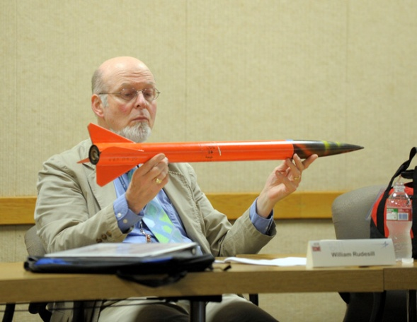
What is the timeframe?
Application Process
December-March: Complete application
March-May: Express interest in Fellowship projects
April-May: Interview for placements
Fellowship
June-August (June 17-Aug 9)
Complete an eight-week Fellowship, working 8 hours per day, 40 hours per week during standard business hours on Host project.
Attend all of the following mandatory meetings (as part of the above hours): IISME Orientation, Midsummer, End-of-Summer Celebration, one-on-one IISME Coach sessions, and Community Group meetings.
Education Transfer Plan (ETP) Implementation
September-May
Implement ETP at your school
Complete Impact Report
Photo Credit: Lockheed Martin Corporation
Notes:
Recommend have application submitted by mid-Feb at latest to go through approval process in time for position postings in March.
Hopefully placed by May, but some in June.
IISME Meetings: required/paid time
-Orientation—help prepare for what to expect
Mid-Summer- peer feedback on ETP
EOS- party

Slide 15

Who can I contact for more information?
Please contact:
Shari Liss, Education Director sliss@iisme.org OR
Christina O’Guinn, Education Manager coguinn@iisme.org
Apply online at: www.iisme.org
Notes:
Some helpful hints that will make it more likely to be selected:
The sooner you get your application in, the better. You will get lots of support from IISME staff on improving your application so that it’s attractive to Hosts when they start their selections in March.
Please contact us with additional questions.

